Slide 1


RentMe
Group3
CSCI-5308
Prof: Tushar Sharma

Slide 2


Team Information
Project Name: RentMe
Client Team: Group 16
Team members:
Smriti Mishra-B00904799
Shiva Shankar Pandillapalli-B00880049
Ferin Rakeshkumar Patel-B00891975
Chirag Jayeshkumar Pancholi-B00911403
Paras Patel-B00911202

Slide 3
PROJECT OBJECTIVES
Designed and developed a Web based application for renting real estate.
This application provides a single platform for choosing the best deal for the real estate by providing all the deals available on major real estate renting sites like Kijiji, Capreit, killam etc.
The objective for making this Web based app is to ease the real estate finding process.
It is an user interactive application with Google maps integrated into it. So that it helps the user to find the real estate properties at a pin-point location.

Slide 4

Meeting Statistics
Meetings with Client team: 6
Meetings with TA: 3 teams meeting and apart from that we were getting continuous feedback from our TA on teams platform.
Our internal meetings: 12

Slide 5
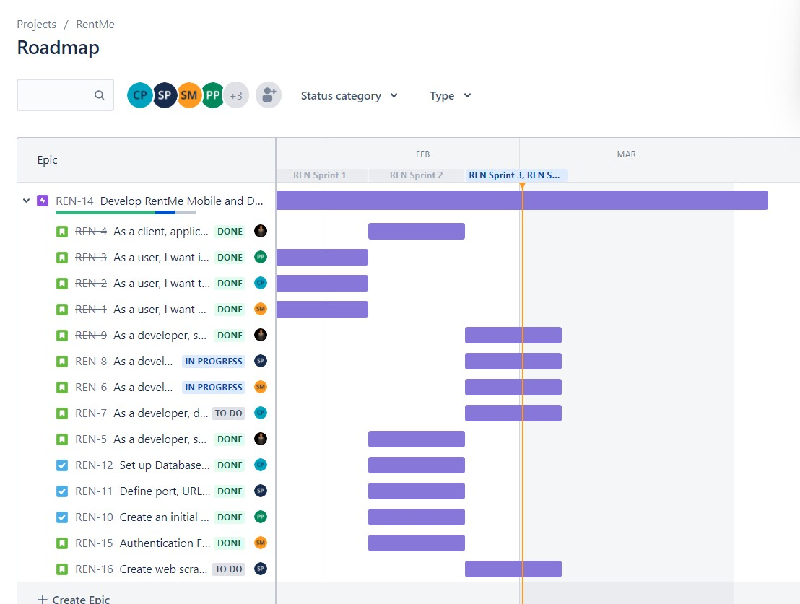
Jira Board

Slide 6
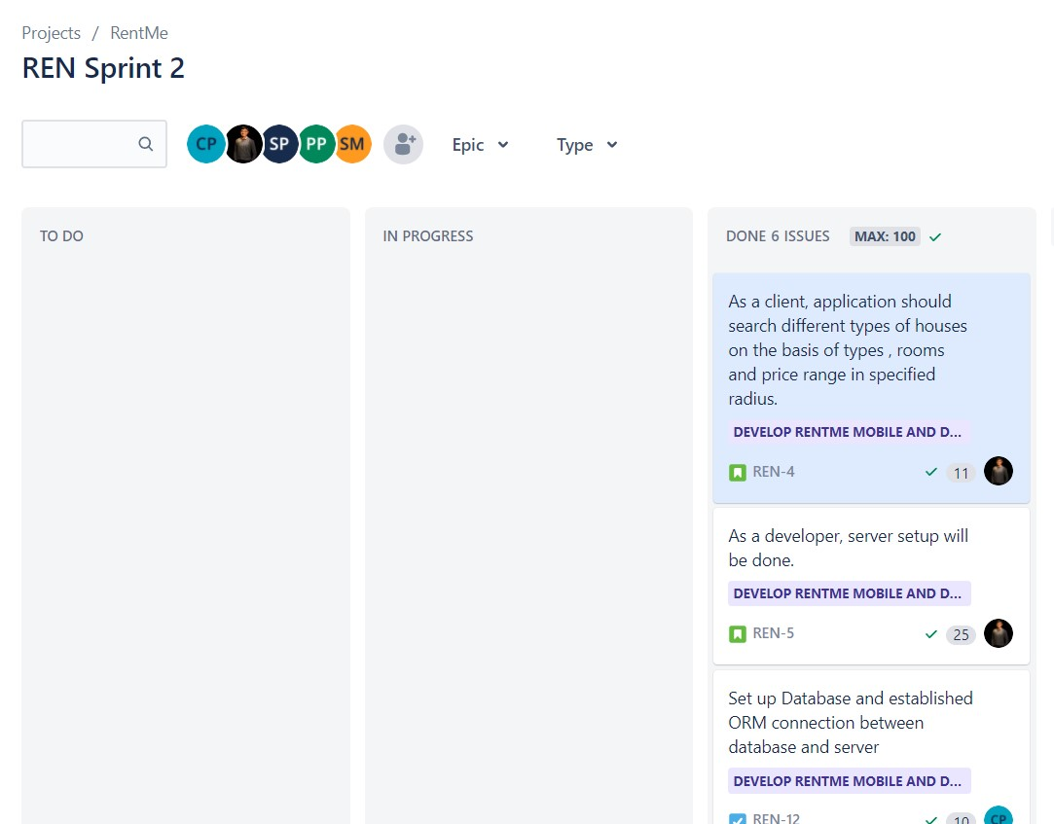
Sprint 2

Slide 7
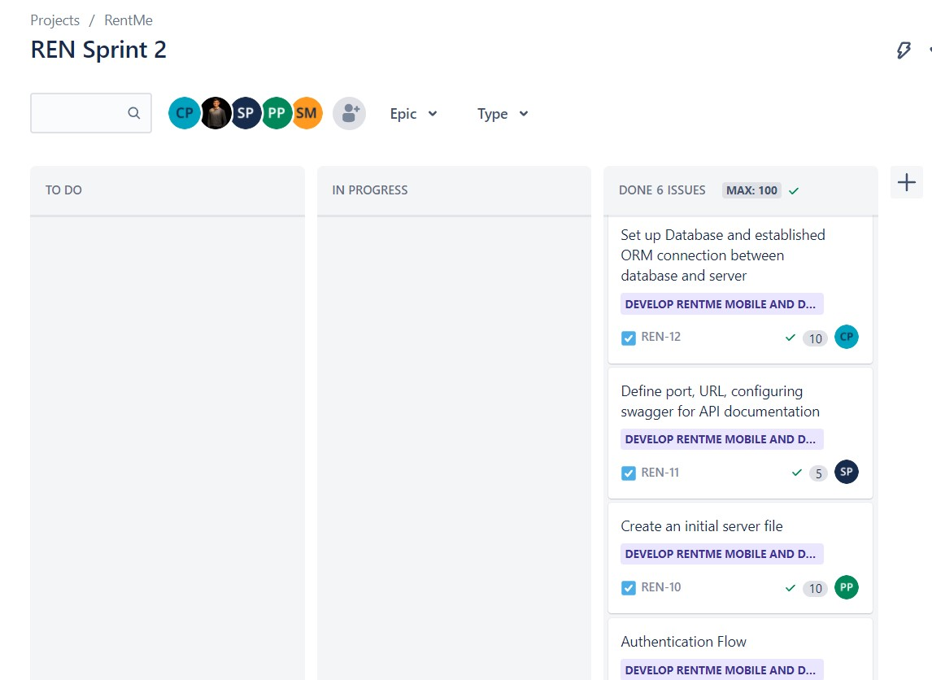
Sprint 2

Slide 8
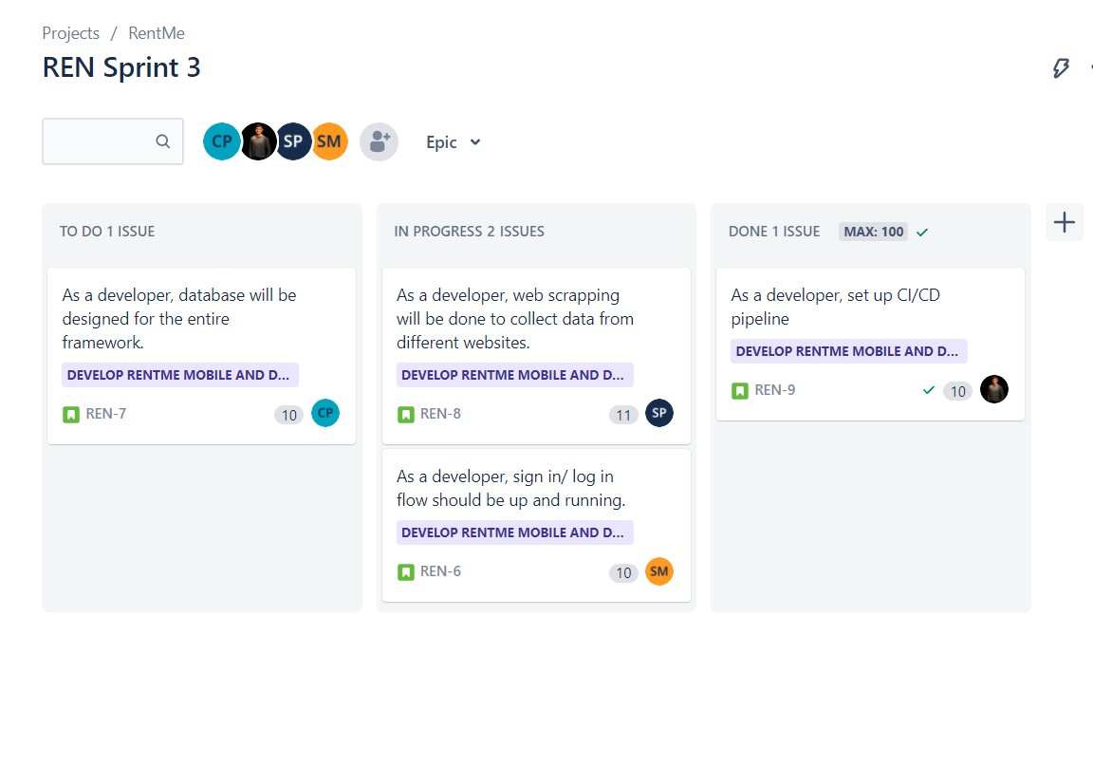
Sprint 3

Slide 9

Tech Stack
Back-end-
NestJs
Front-end-
ReactJs
Database-
PostgreSQL
Hosting-
Netlify- Front end
Heroku- Back end and Database.

Slide 10
Major milestones
Authentication flow is ready.
CI/CD pipeline is ready and working.
Dummy front end UI is ready.
Successfully integrated 2 GoogleAPIs: 1) Maps 2) Places Auto Complete.
Successfully implemented DataScrapper for Kijiji.
API’s are working

Slide 11
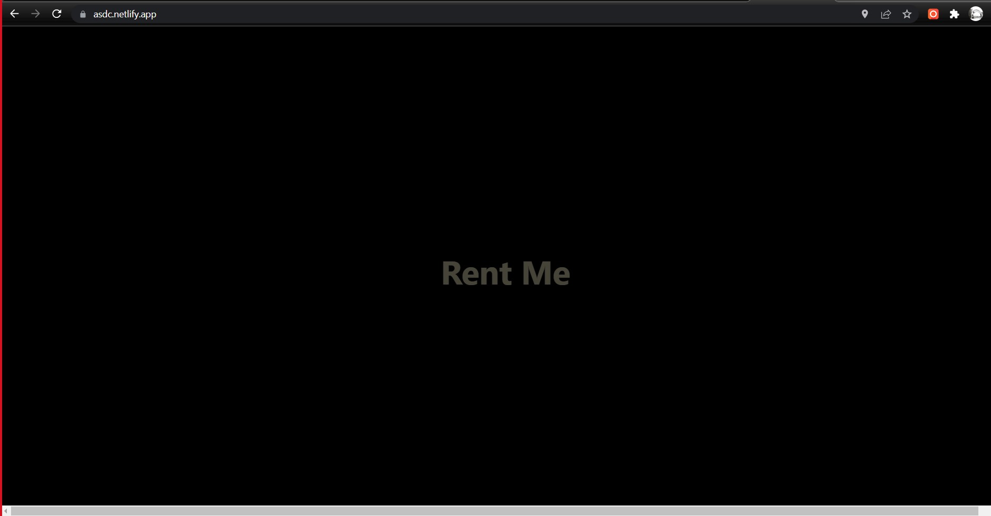
Demo screenshots

Slide 12
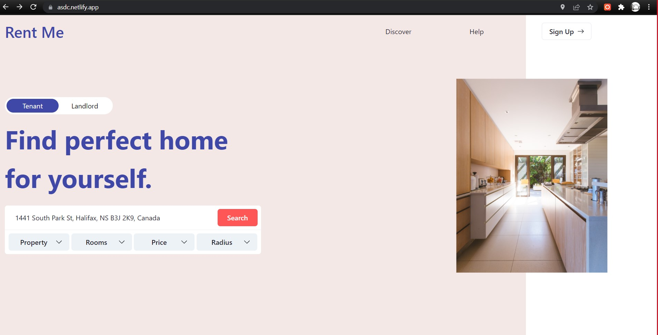
Home Page

Slide 13
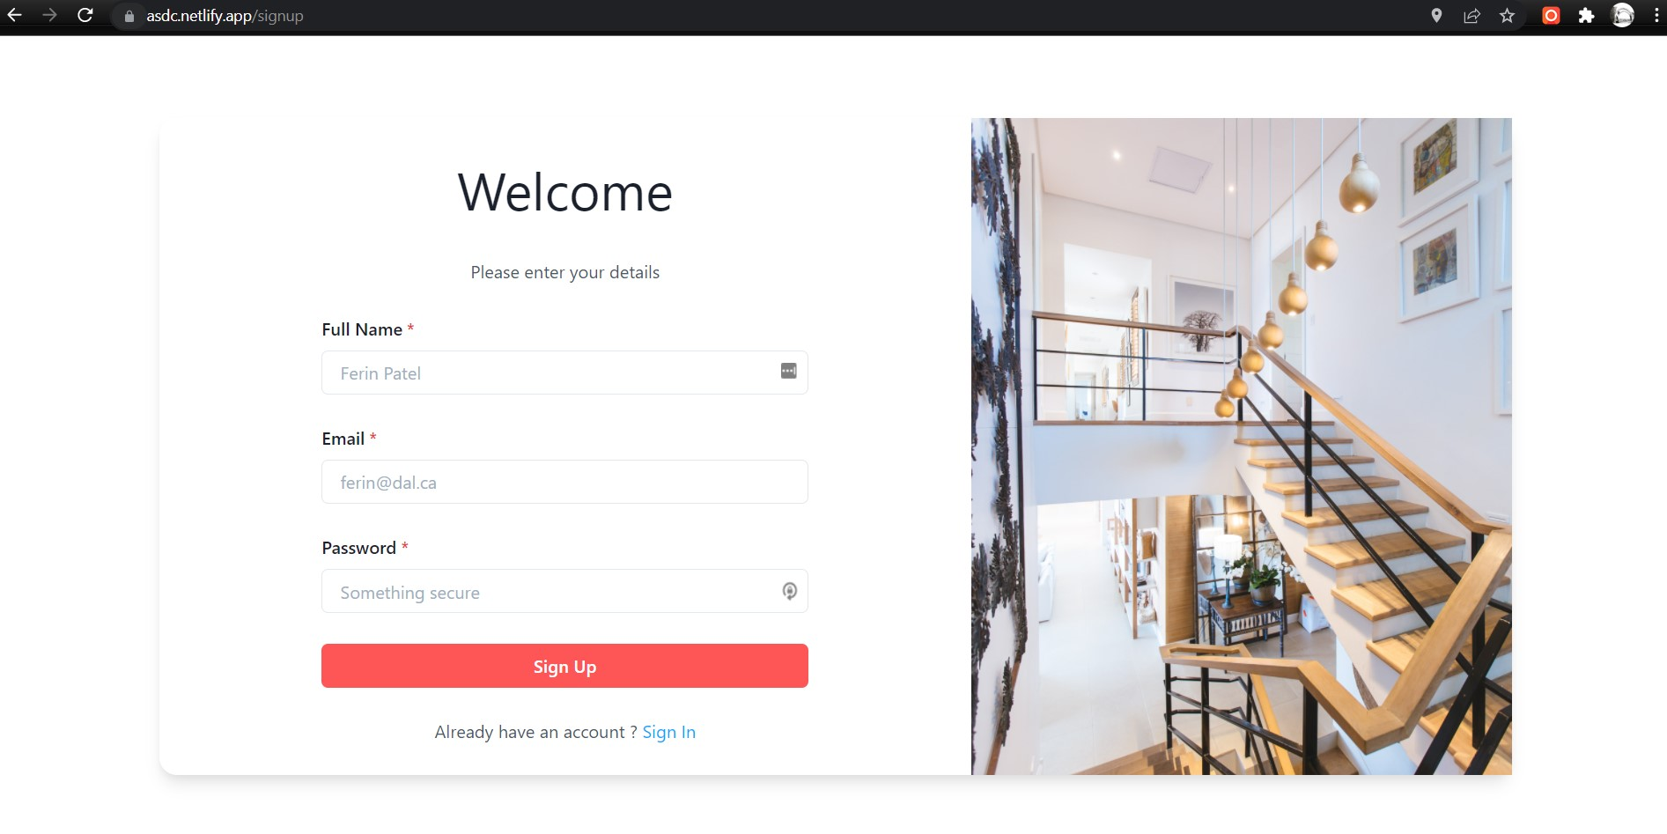
Sign-up Page

Slide 14
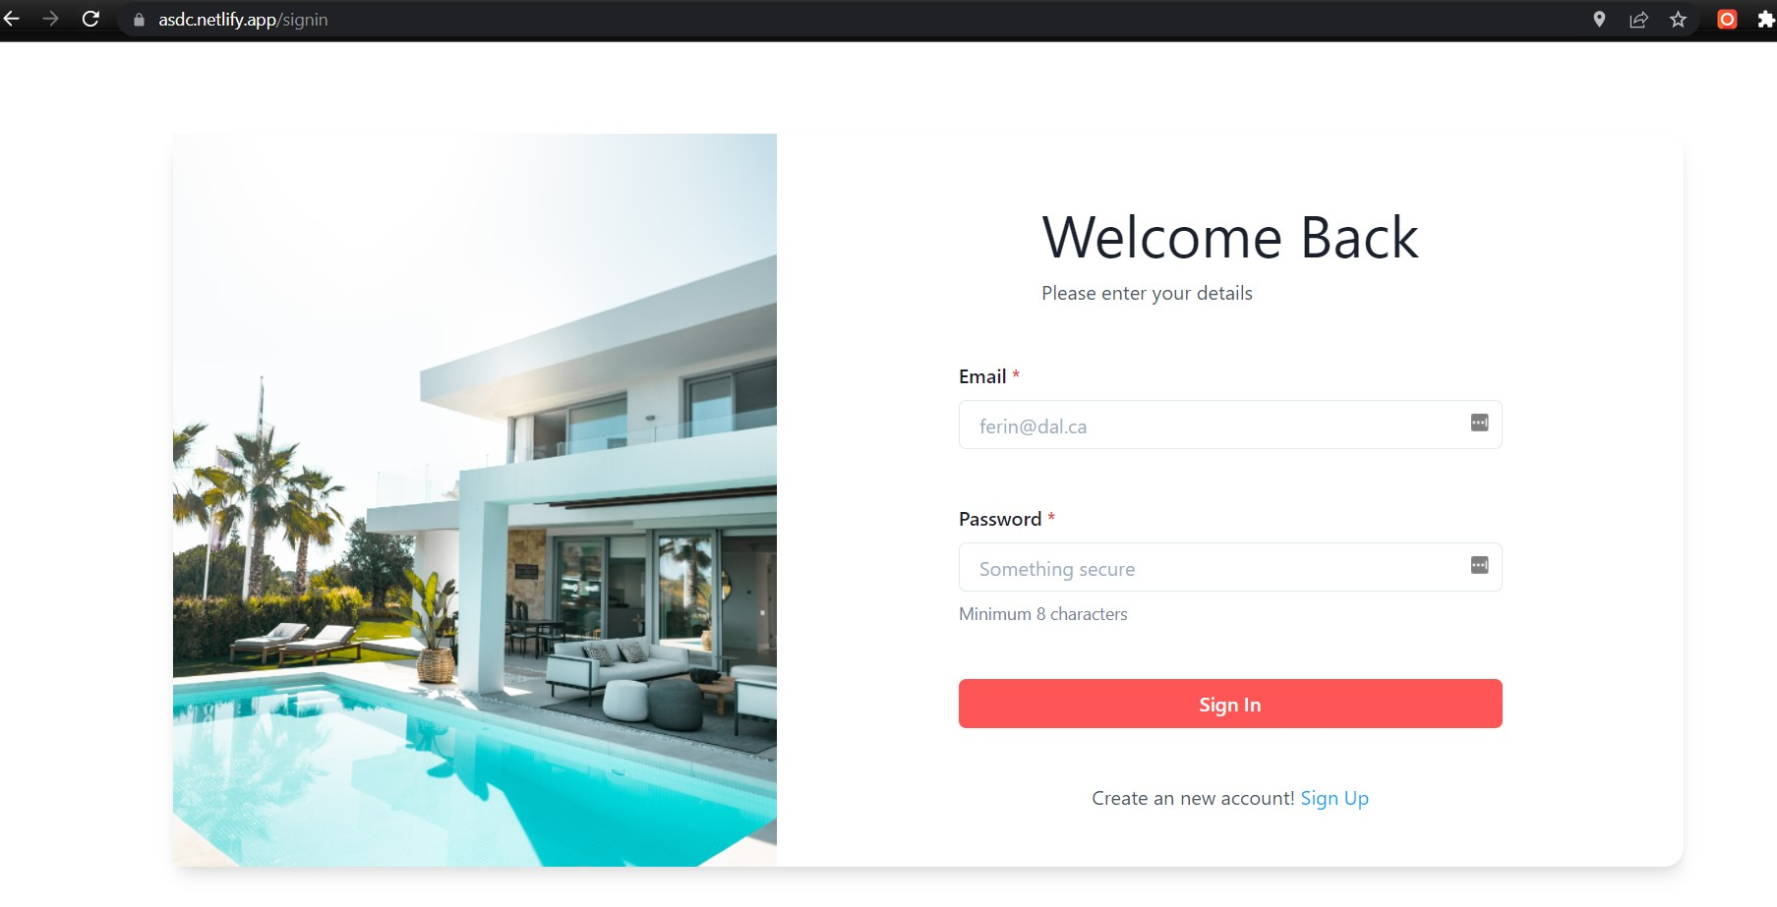
Login Page

Slide 15
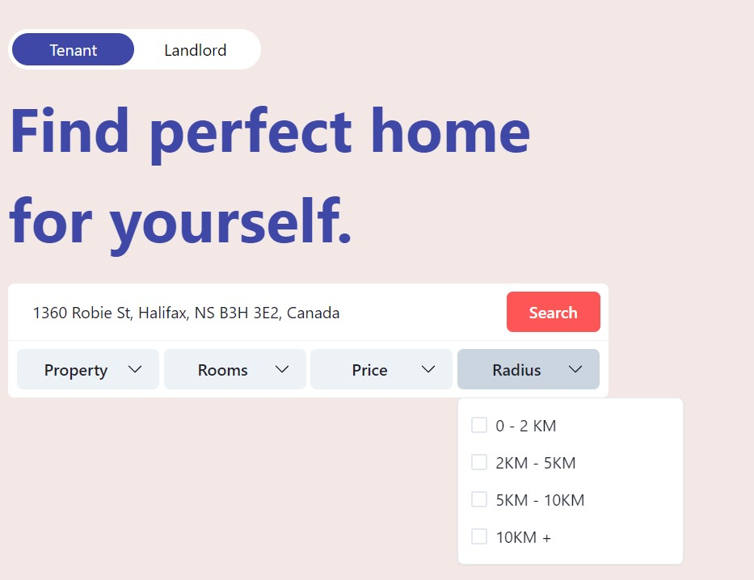
Filters

Slide 16
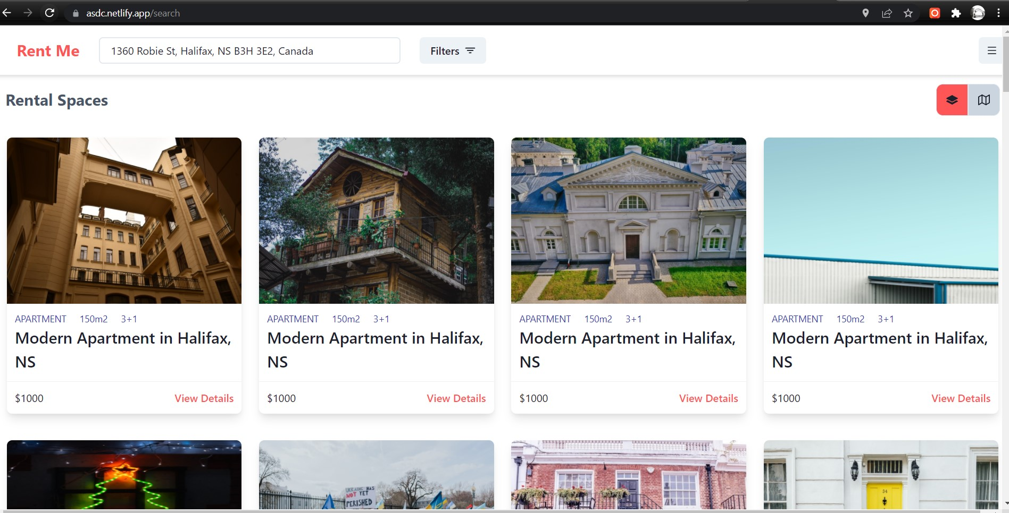
Search Page

Slide 17
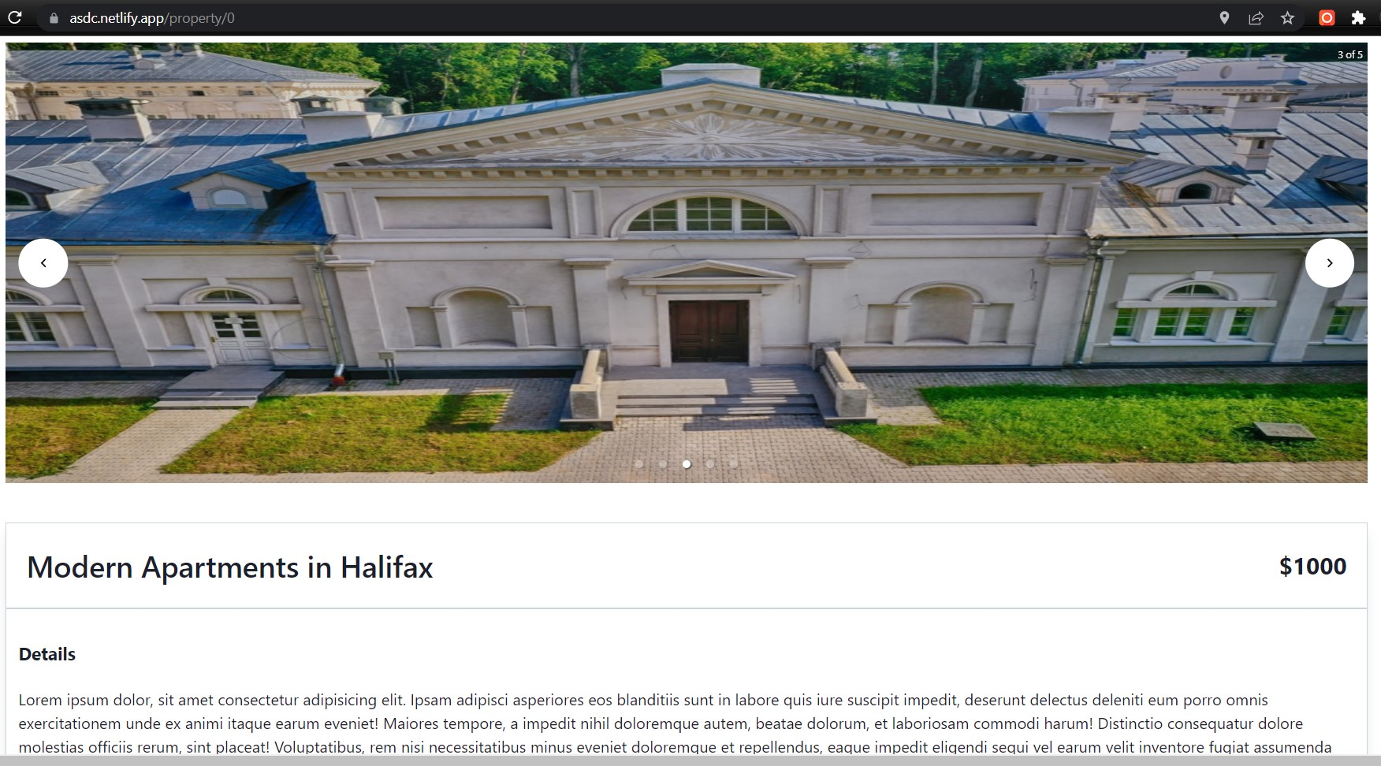
Details of Housing

Slide 18
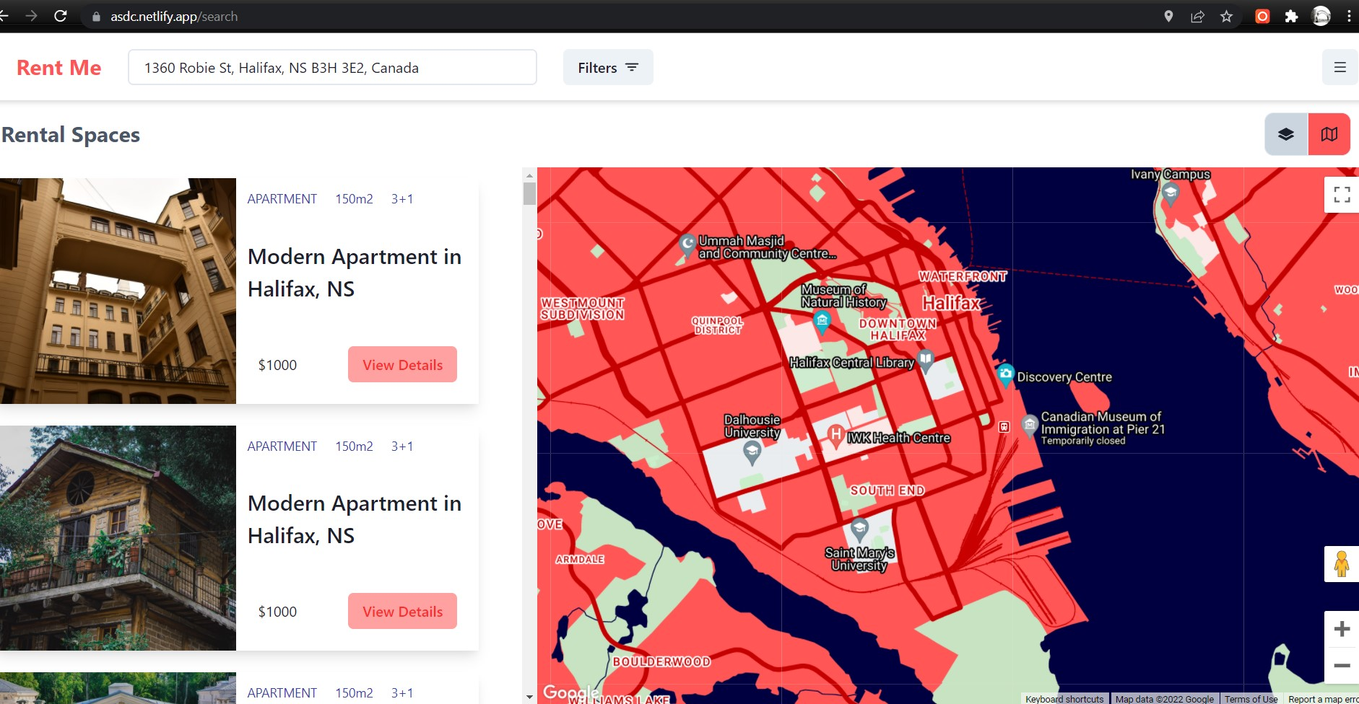
Map Integration

Slide 19

Project Status
Features | Status
CI/CD Pipeline | Done
User Authentication (Login & Signup) | Done
Web Scrapping for websites | Done for Kijiji. In progress for other websites.
UI development for listing | Done
Google Maps integration | Done
Google Places auto complete | Done
Responsive Design | Done

Slide 20
Challenges
When we were setting up the Kijiji DataScrapper, the rendered HTML had unique CSS classes each time, so it was hard to grab any particular element from the DOM.
Solution: We ended up finding the text content and validating with custom logic

Slide 21
Next Steps
Implementing the remaining features.
Cloudinary setup and integration with server.
Implementing WebScrapper for other websites.
API integration.
Configuring servers for sending emails.
Code Testing.

Slide 22

Thank you

